Slide 1
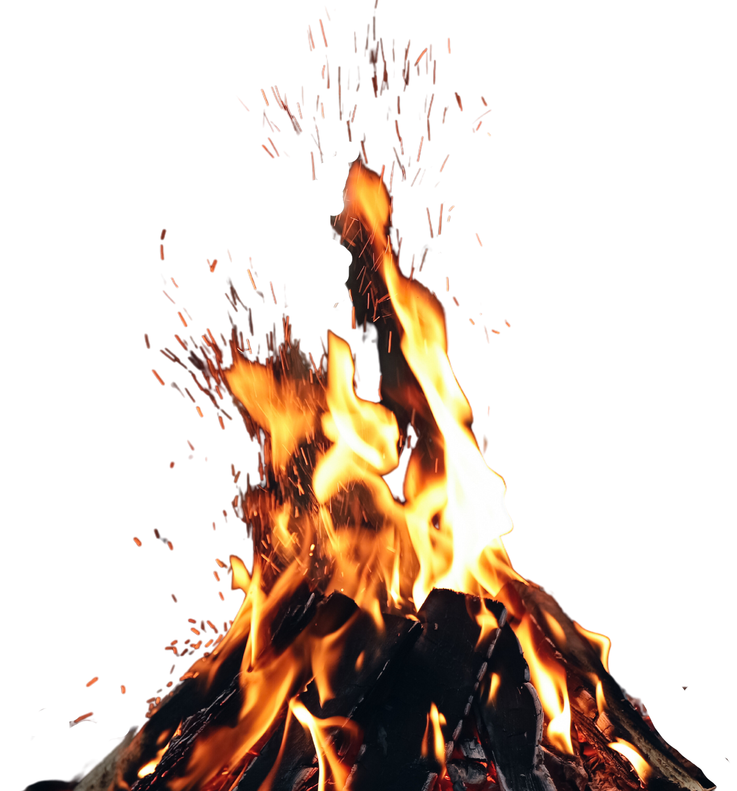
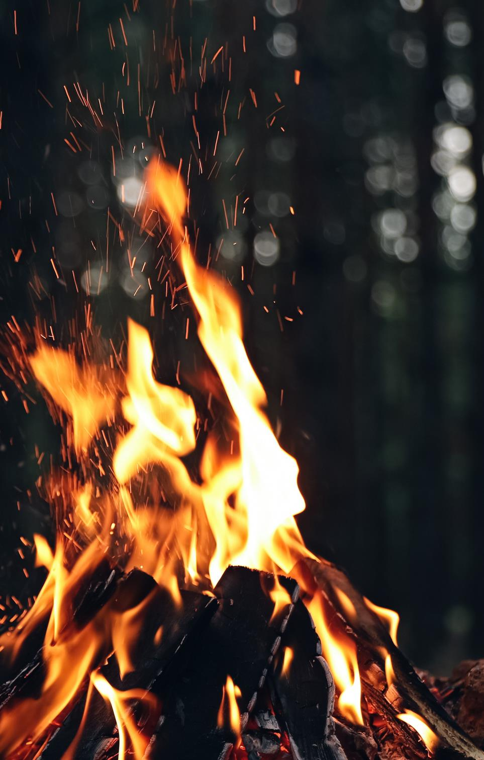


FIREWORK &
BONFIRE SAFETY
SECONDARY SCHOOL LEVEL
Notes:
Introduce yourself, where you work, what your role is and why you are there? ​
​
Learning Objectives​
How to act safely and sensibly around fireworks and bonfires​.
How to become aware of the fire work code.​
Understand why it is better to attend an organised local display if possible.​

Slide 2
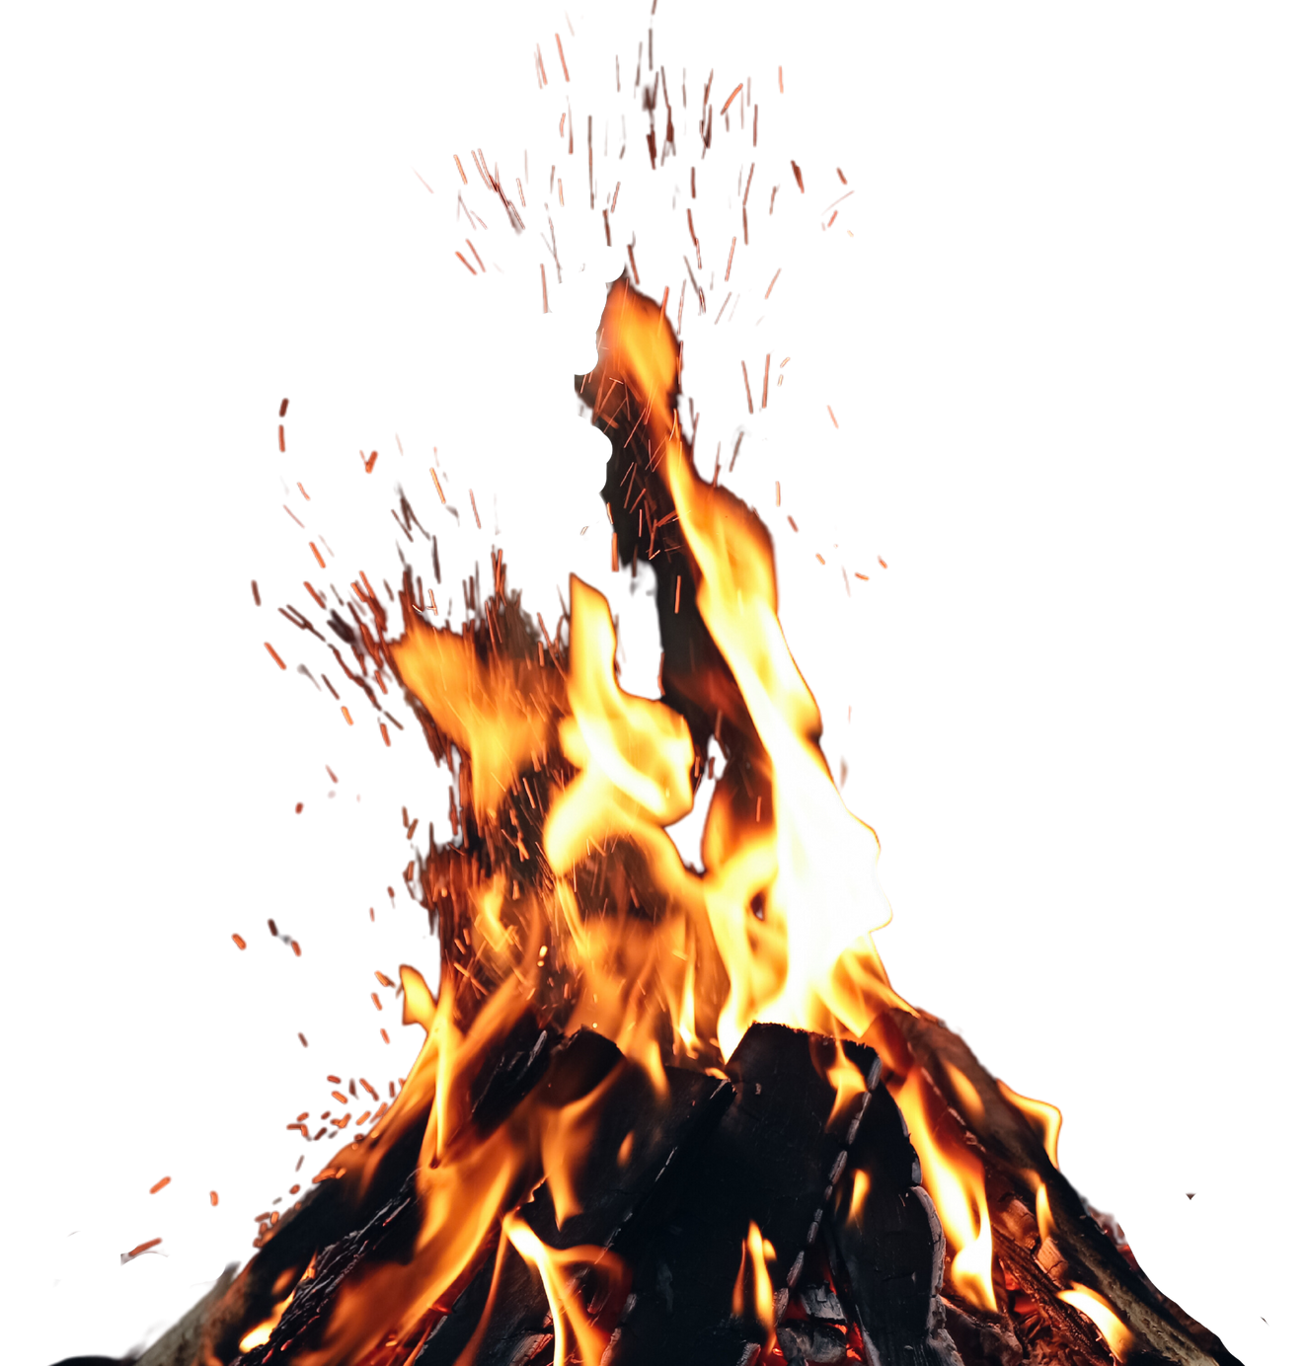
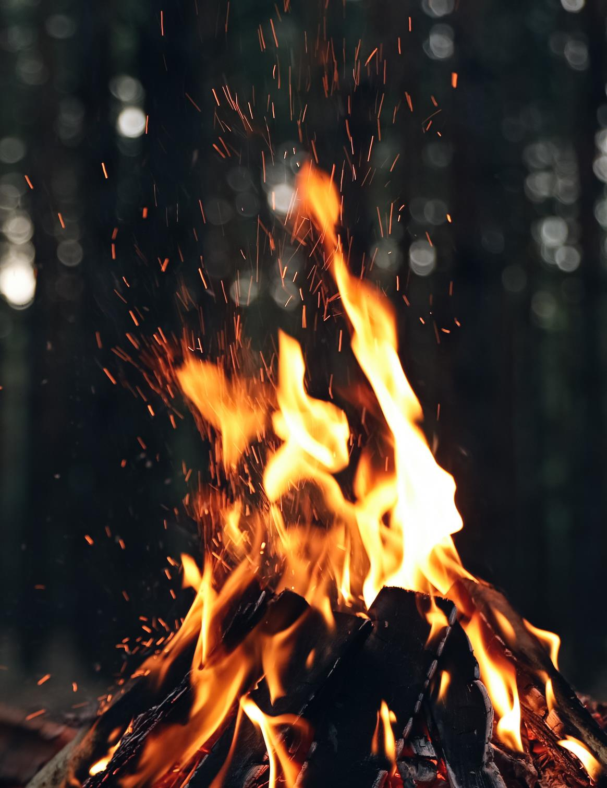


BONFIRES
We always recommend that you attend an organised bonfire / fireworks display.
You will find a list of organised events on our website.
If you are having a bonfire:
think of the impact.
If bonfires are close to trees, sheds, wheelie bins and fences - fire can spread and cause more damage.
VISIT FIRESCOTLAND.GOV.UK
FOR A LIST OF ORGANISED EVENTS
Notes:
Unsupervised bonfires put an additional strain on SFRS. It is therefore more important to make sure if you need to have a bonfire that you and those with you are safe.
ASK
If your parent/guardian is having a bonfire, what should they consider?
ANSWER
One person should be responsible for the bonfire.
Children should be supervised always.
Keep a safe distance away from lit bonfires.
Never throw fireworks or aerosols into bonfires.
Keep a bucket of water handy in case of an accident.
Avoid loose clothing and tie back long hair.
At the end of the night, ensure that the fire is properly extinguished rather than leaving it to burn out.
ASK
What is a safe Bonfire?
ANSWER
The following criteria in considering if the bonfire is safe:
• It is positioned more than 18m from buildings.
• It is less than 2.5 m in height.
• It is positioned away from overhead cables.
• There are no ‘secondary hazards’ within it (particularly gas cylinders/aerosols)
• The bonfire is being supervised by a responsible adult.
If you are having your own bonfire, remember to check for animals getting ready to hibernate.
Reinforce that SFRS recommend everyone to attend an organised event. You can find your nearest one on the SFRS website,
And local Press.

Slide 3

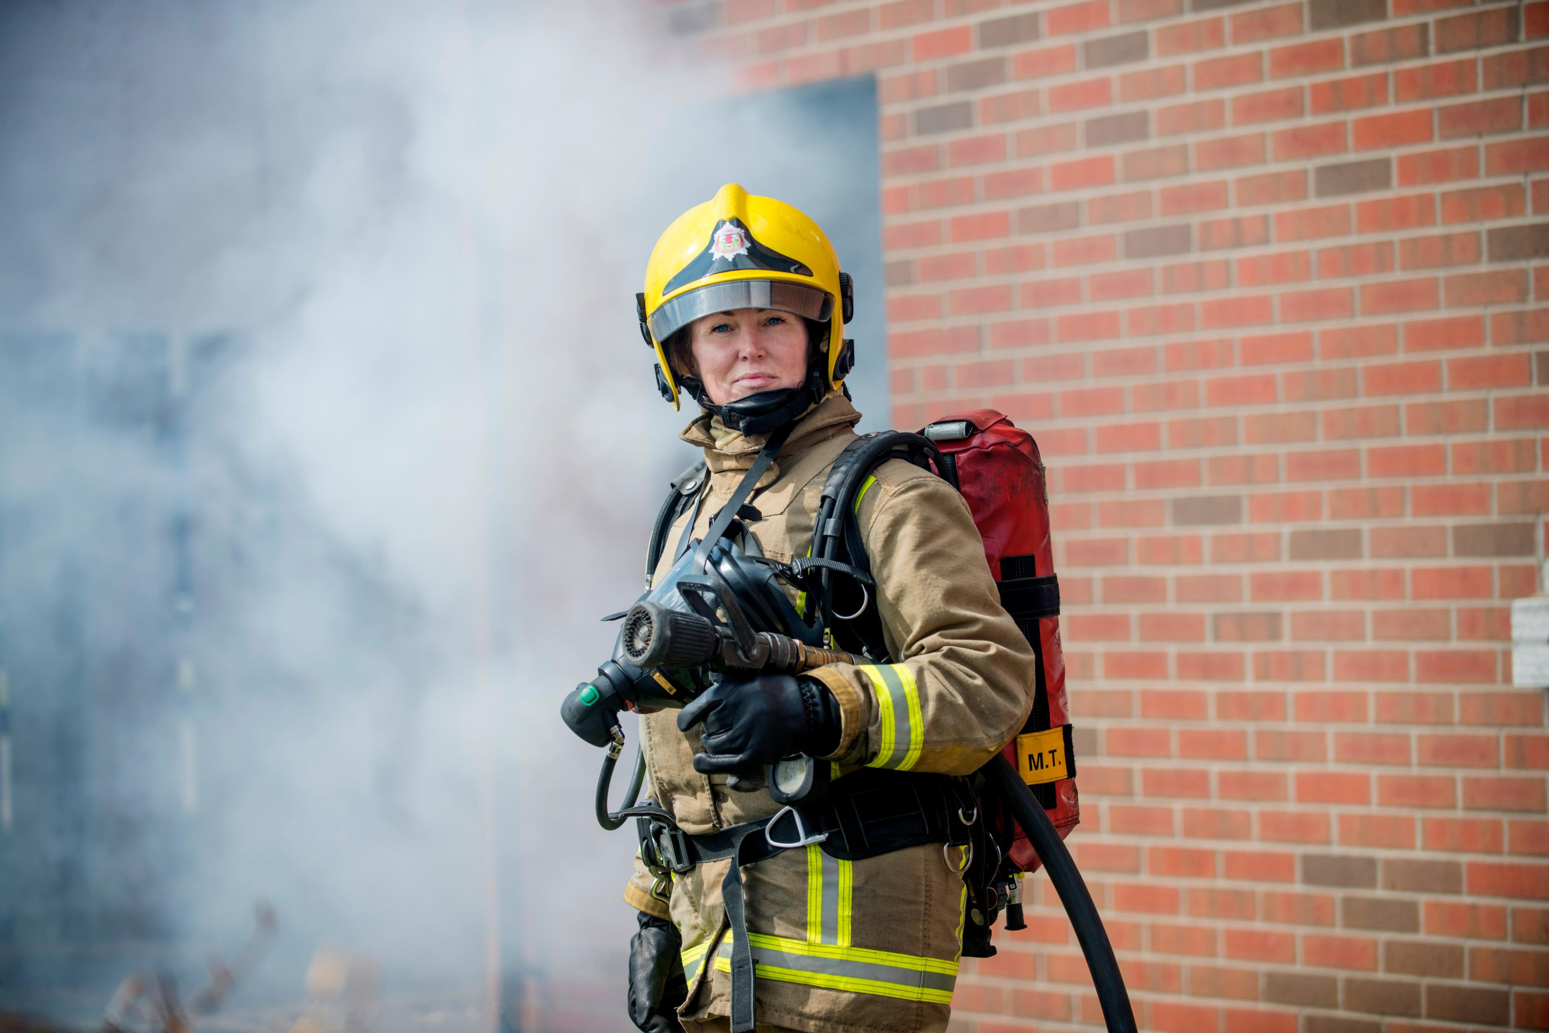
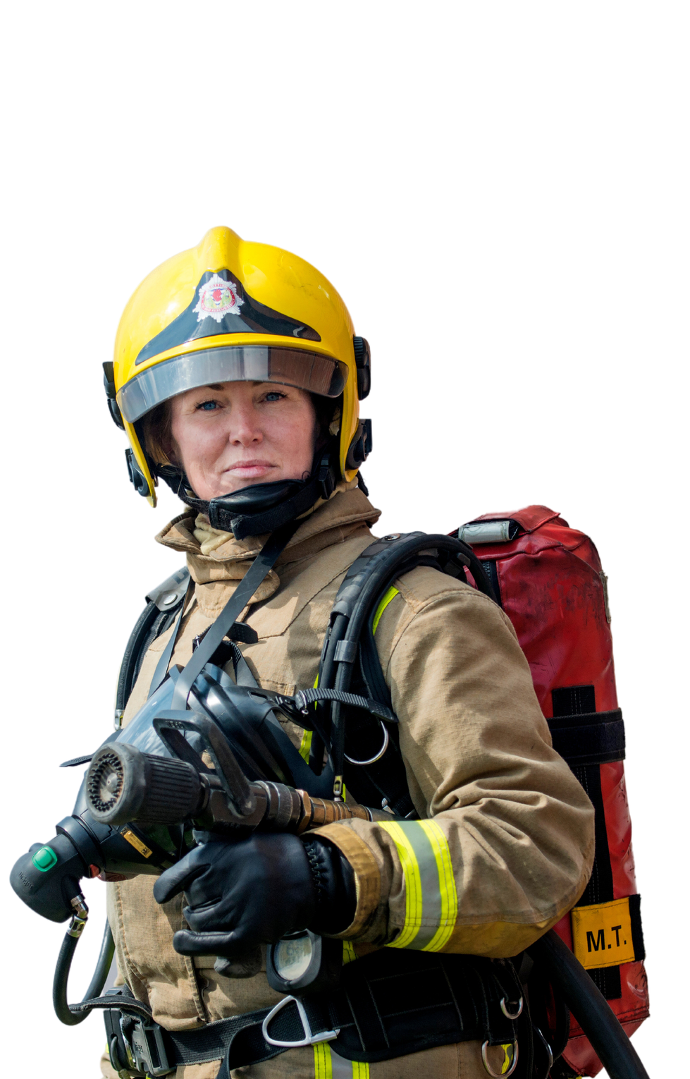
SOME KIDS STARTED
THE BONFIRE
FOR A LAUGH...
...IT COULD HAVE DELAYED US ATTENDING
A SERIOUS HOUSE FIRE.
Notes:
Discuss how unofficial bonfires place a huge strain on fire and rescue resources and that they should help the fire service on bonfire night by attending an official display.

Slide 4
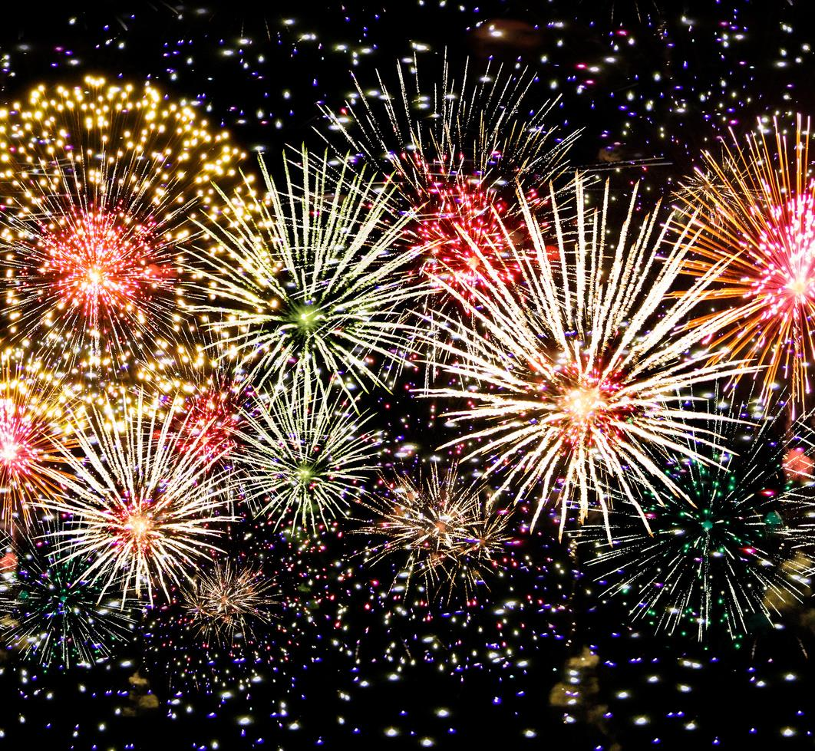

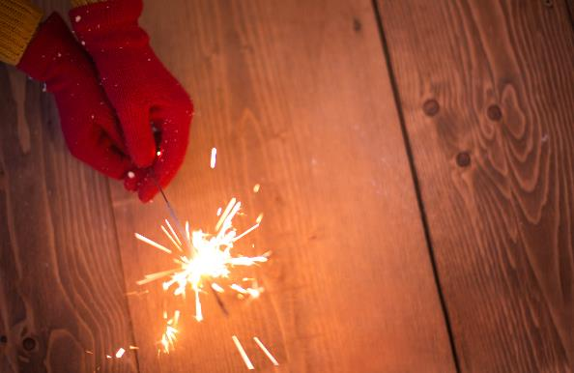
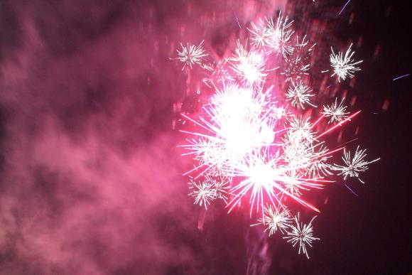
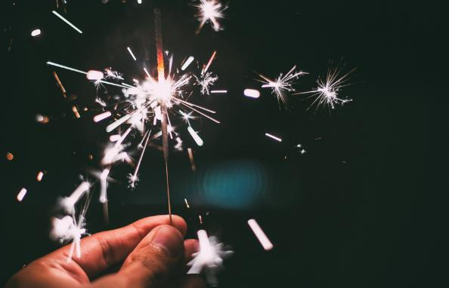
FIREWORKS
Fireworks can be fun …
but they can also be dangerous.
DID YOU KNOW
that sparklers can burn five times hotter than a BBQ?
ALWAYS FOLLOW THE FIREWORKS CODE
Notes:
ASK
Why do fireworks come in different shapes and sizes and are attractive to look at?
ANSWER:
This is a marketing technique as it makes them look exciting and fun. It is one of the ways that the firework manufacturers can sell these fireworks to the parents or guardians of the pupils and the public
Ask
How hot can sparklers get?
Answer
Sparklers can burn up to temperatures of 1500 degrees (5 times hotter than a BBQ) with fireworks reaching temperatures even hotter. These can cause a wide range of injuries including superficial and life altering injuries.
ASK
How old would you be before the burns go away?
Answer
It will never fully go away

Slide 5
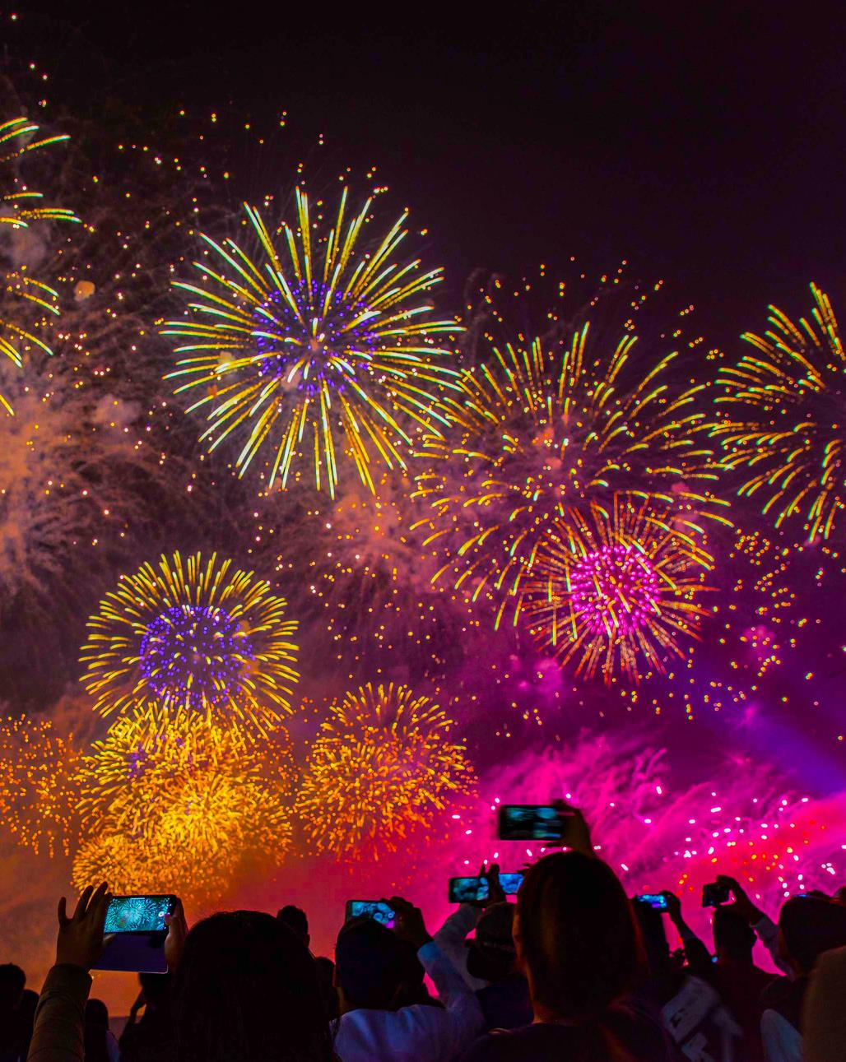

IF YOU ARE UNDER 18
YOU CAN'T BUY FIREWORKS
BUT YOU CAN HELP
by telling an adult all about The Fireworks Code

Slide 6

THE FIREWORKS
CODE
Follow the instructions on each firework
Direct any rocket fireworks well away from spectators
Light the firework at arm's length with a taper
Never use paraffin or petrol on a bonfire
Keep naked flames, including cigarettes, away from fireworks
Make sure that the fire is out and surroundings are made safe before leaving
Never return to a firework once it has been lit- even if it hasn't gone off it could still explode.
Only buy fireworks with a CE mark or the UKCA mark
Don't put fireworks in pockets and never throw them
Notes:
Discuss the firework code.
Follow these simple guidelines to stay safe:
Only adults should deal with setting up firework displays, the lighting of fireworks and the safe disposal of fireworks once they have been used (and remember, alcohol and fireworks don't mix!).
Children and young people should be supervised and watch and enjoy fireworks at a safe distance.
Plan your firework display to make it safe and enjoyable, and ensure it finishes before 11pm (24:00 on 5th Nov, 01:00am for New year's eve, Diwali, and Chinese New year)
• Follow the instructions on each firework - read them in daylight or by torchlight, never by a naked flame.
• Light the firework at arm's length with a taper and stand well back.
• Keep naked flames, including cigarettes, away from fireworks.
• Only buy fireworks with a CE mark, keep them in a closed metal box - take them out one at a time.
• Never return to a firework once it has been lit- even if it hasn't gone off it could still explode.
• Don't put fireworks in pockets and never throw them.
• Direct any rocket fireworks well away from spectators.
• Never use paraffin or petrol on a bonfire Make sure that the fire is out, and surroundings are made safe before leaving.
ASK
Why should Fireworks not be kept in your pocket?
ANSWER
The friction could cause the firework to go off, causing serious injury and permanent damage.

Slide 7

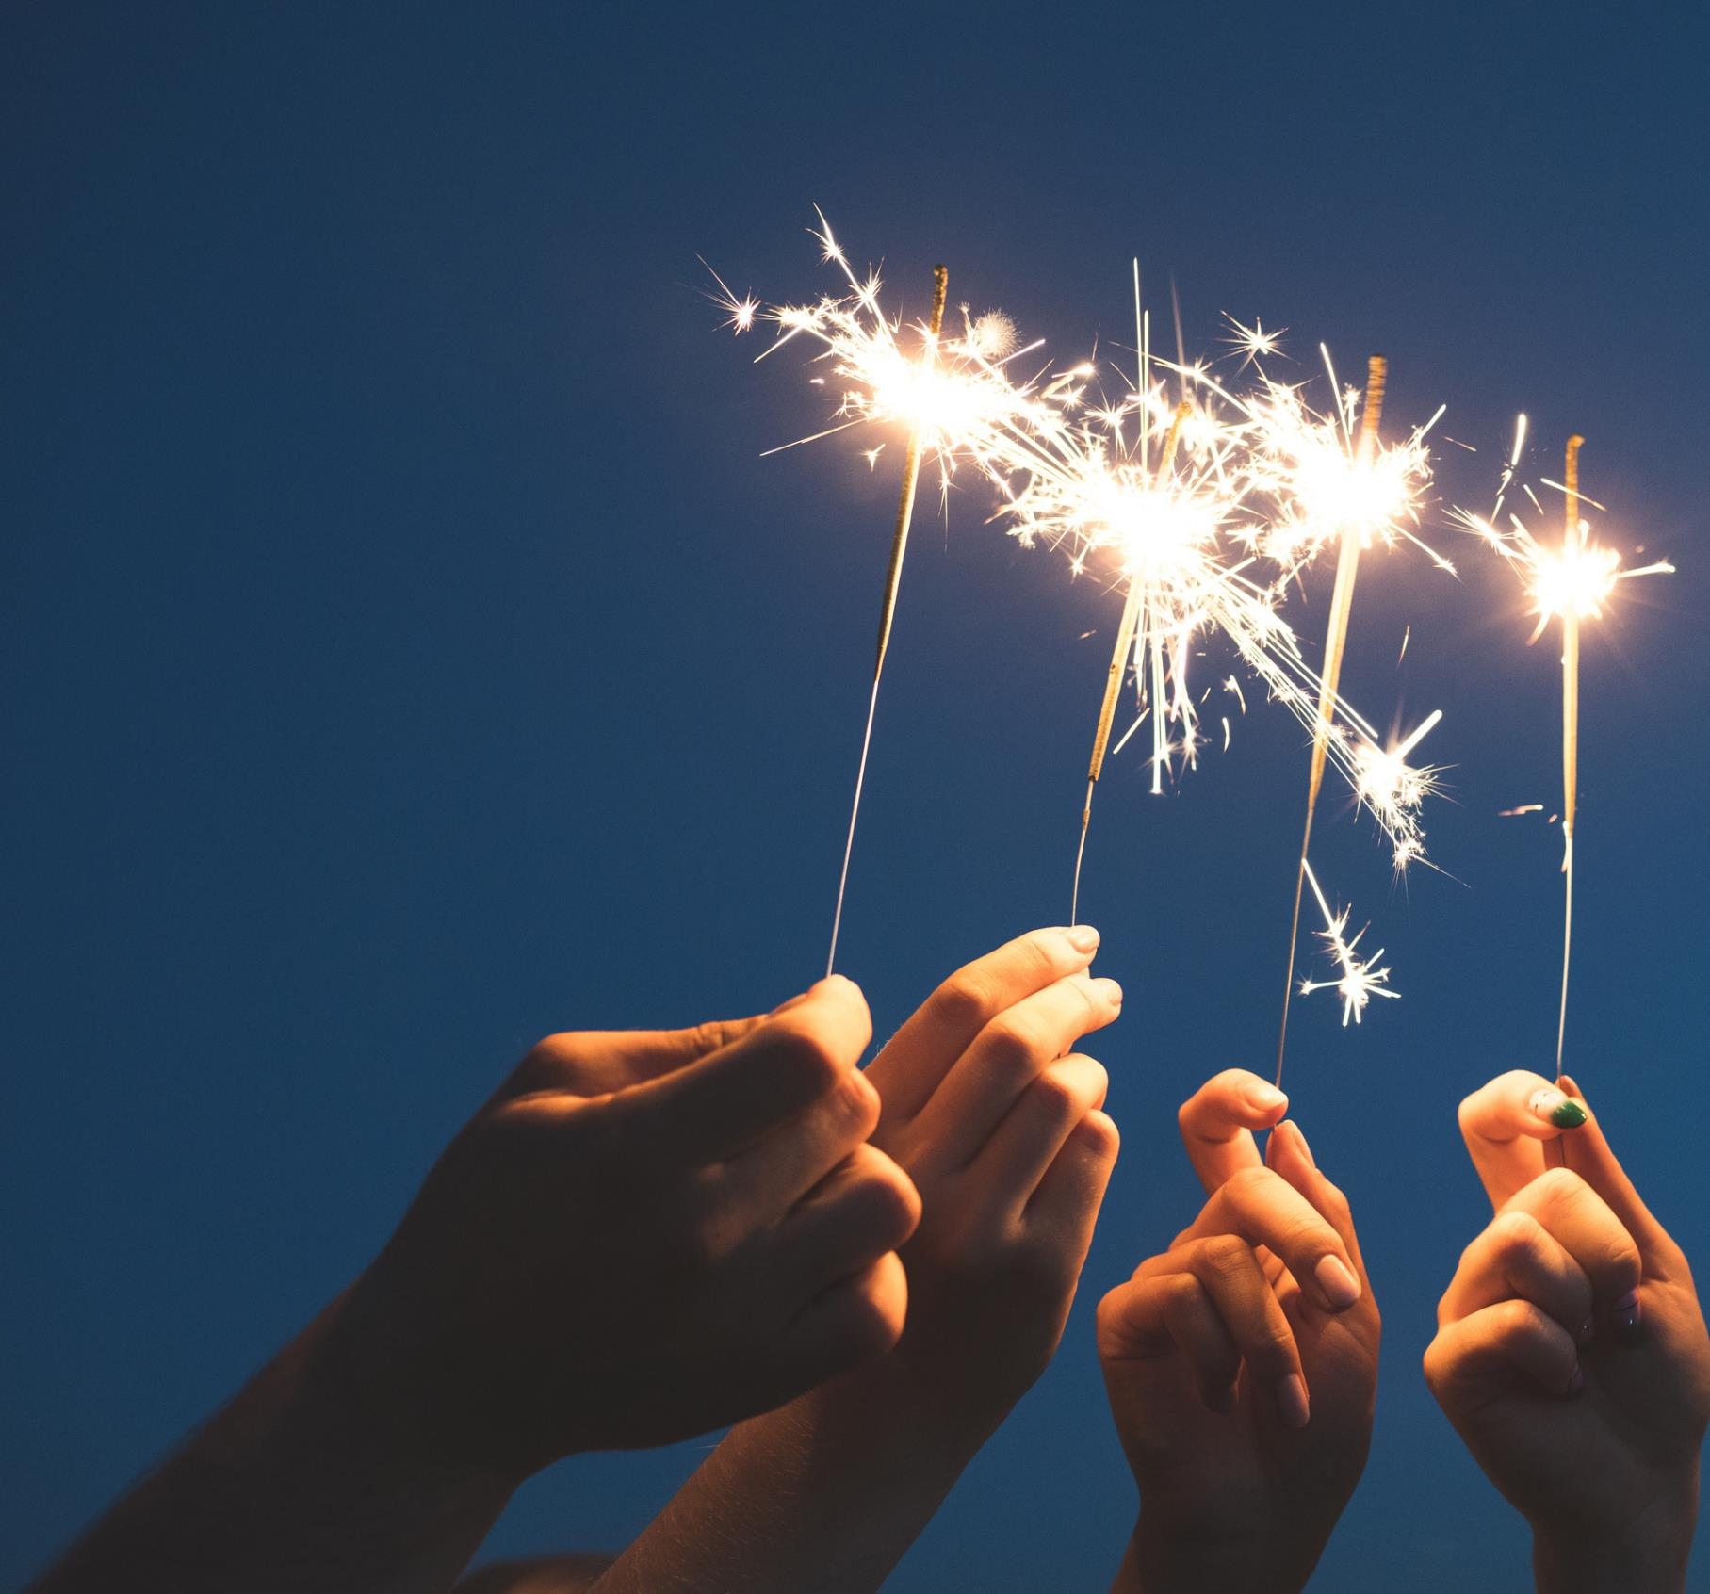
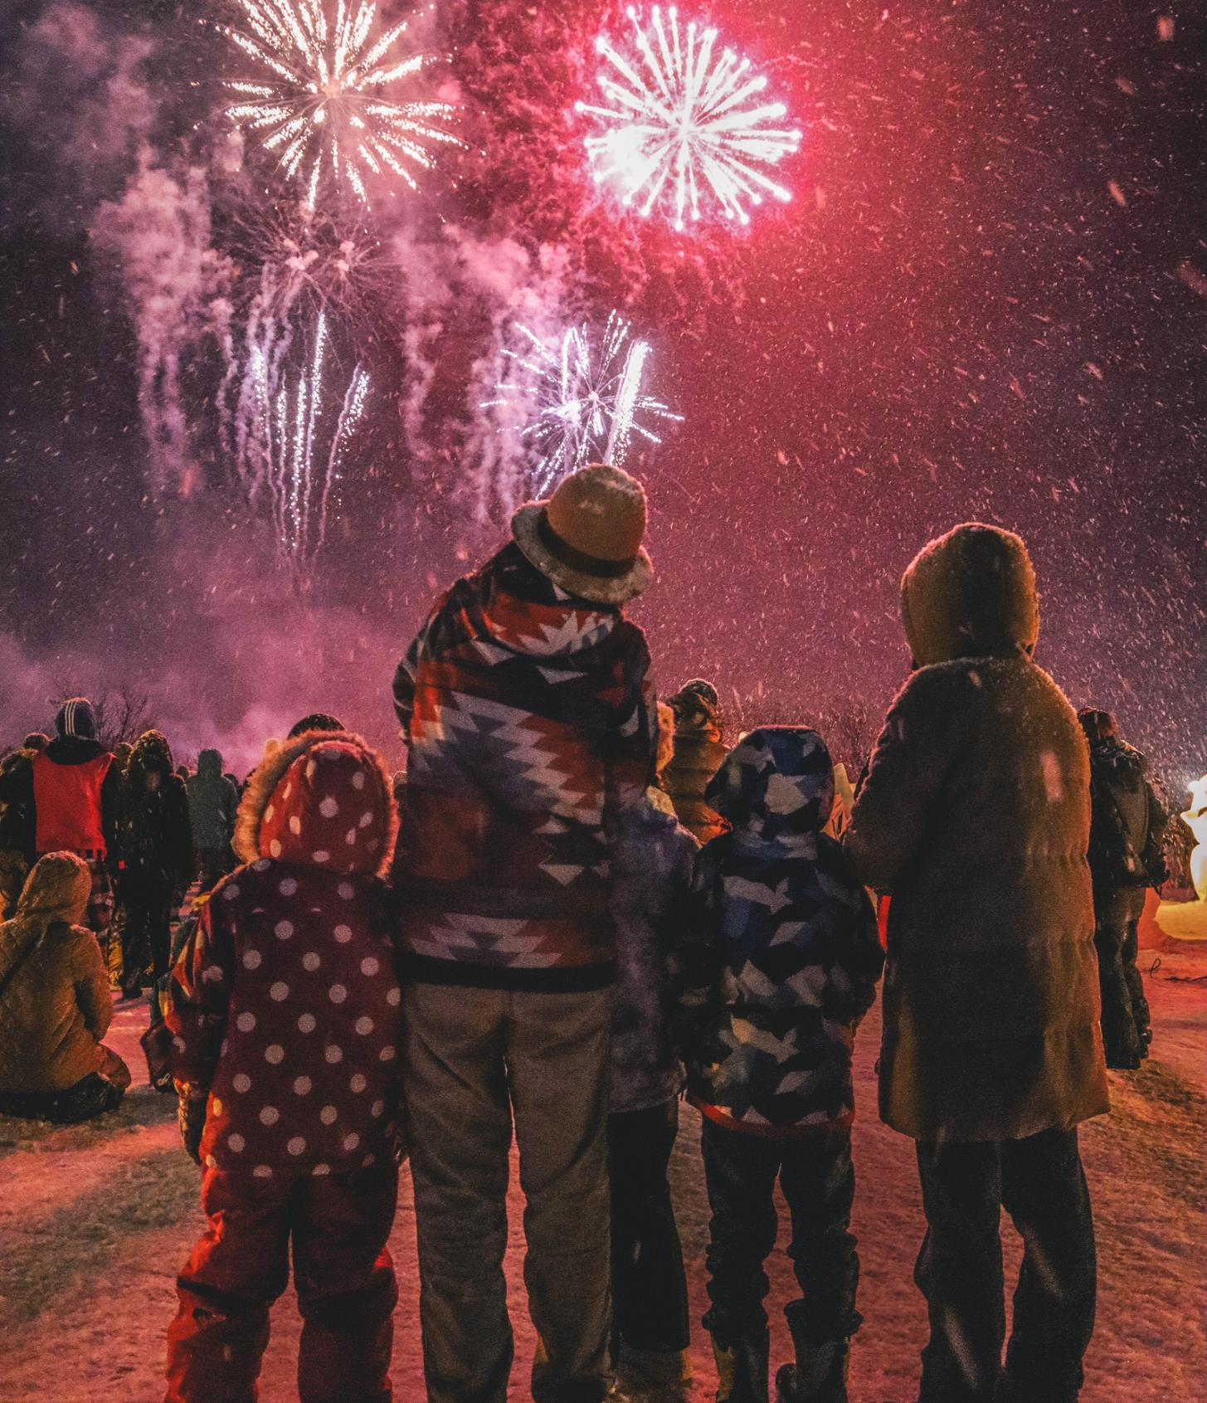
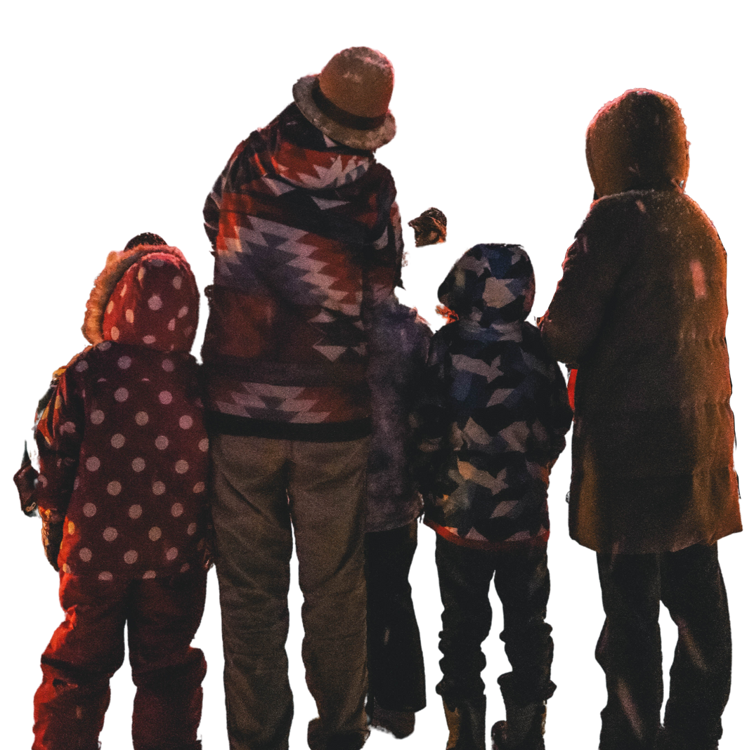
REMEMBER
ONLY ADULTS
SHOULD BE LIGHTING FIREWORKS AND SETTING BONFIRES.

Slide 8
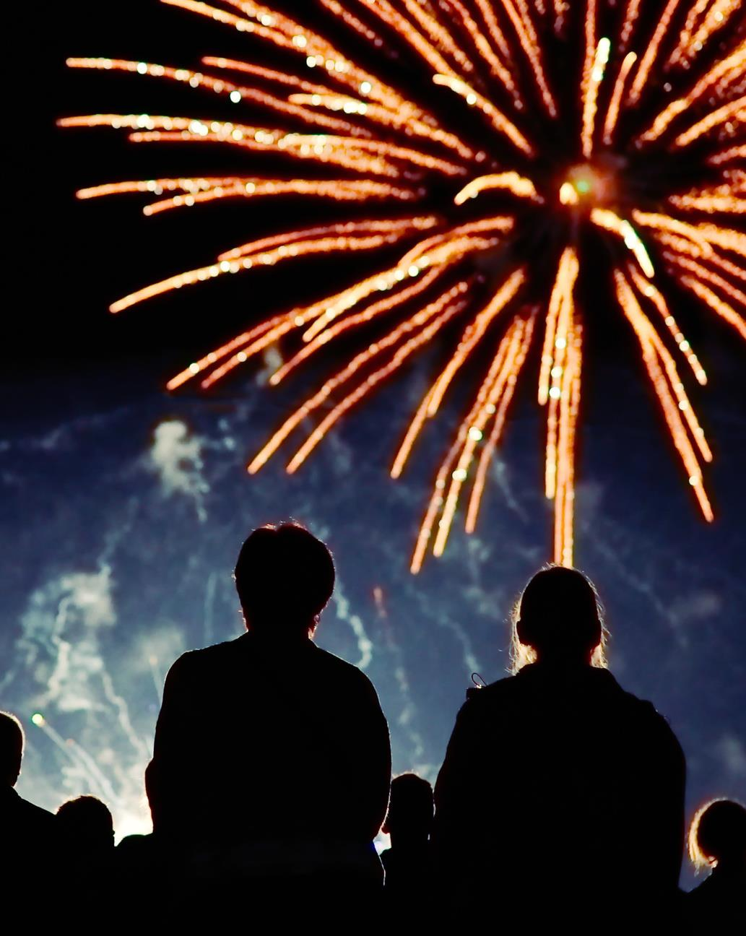
THE
LAW
It is illegal
to set off fireworks before 6pm and after 11pm
This extends
to midnight on the 5th November
It is illegal to buy or give fireworks to anyone under the age of 18
with the exception of F1 fireworks.
Examples of F1 fireworks include
party poppers, novelty crackers and certain sparklers.
Notes:
Unless you have a ‘reasonable excuse’ or are exempt, it is against the law to have:
• any firework or pyrotechnic other than category 1 fireworks (for example party poppers, novelty crackers and sparklers) in any public place including the street and parks
• any firework (including category 1) or pyrotechnic, such as handheld flares, at sport and live music events in venues that can hold 1000 or more people
It is already a criminal offence to take or try to take a pyrotechnic into football matches.
Category 1 fireworks are those which present a very low risk and negligible noise level and which are mainly used indoors. Examples include small sparklers, ice fountains, Christmas crackers and party popper

Slide 9
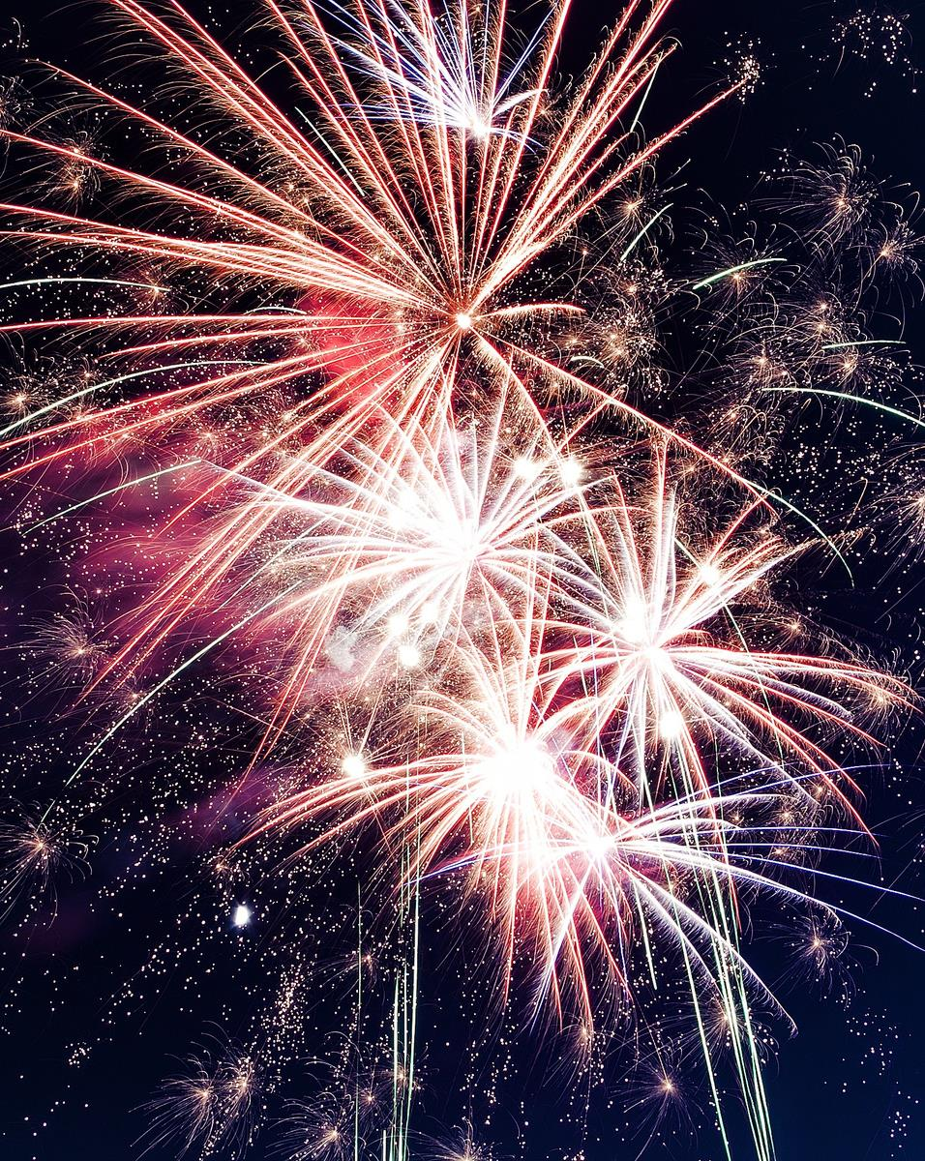
THE
LAW
It is illegal
for anyone under the age of 18 to purchase fireworks.
The category of firework is legally required to
be displayed on product packaging.
It is illegal
to have any firework, other than Category F1, in any public space without reasonable excuse
You can incur a charge of £5,000
if you're caught throwing a firework.
Notes:
You may want to discuss some of the topics below or ask the class if they are True/False
It is an offence:
To set off fireworks (by the public) out-with the hours 6pm and 11pm (or after midnight on bonfire night, 1 am new year's eve, Chinese new year, Diwali).
To modify, tamper with or misuse fireworks.
To throw or set off fireworks in any highway, street, thoroughfare or public place.
To sell fireworks to anyone under 18 and out-with the hours of 7am and 6pm.
For anyone under 18 to possess fireworks in a public place.
For anyone other than a firework professional to possess display category fireworks.
To cause unnecessary suffering to any domestic or captive animals.
To buy more than 5kg of fireworks.

Slide 10

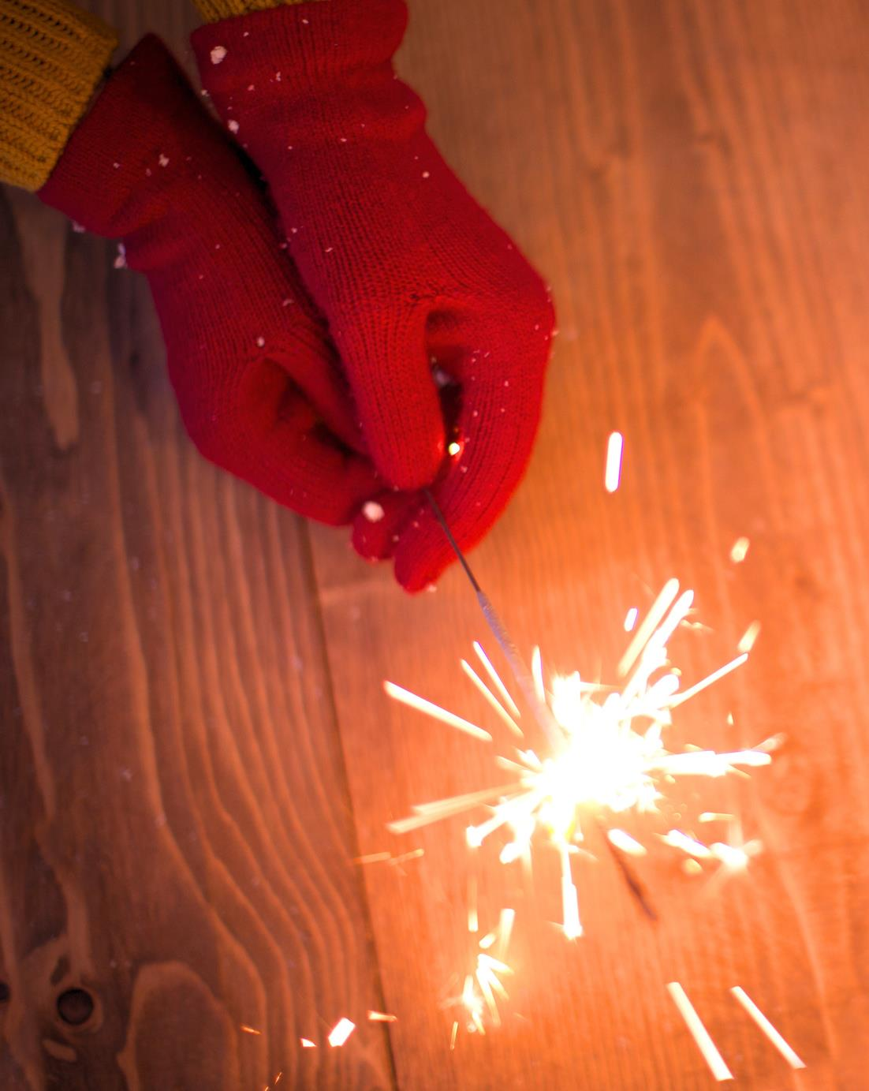
YOUR
SAFETY
Research from the organisation Care of Burns in Scotland (COBIS) reports:
It is teens and children who are most likely to incur injuries from fireworks.
The breakdown of injuries was male (76%) and female (24%)
The most common body part injured was – hand (40%) and face and neck (29%).
The most commonly recorded cause of injury was sparklers.
KEEP YOURSELF AND OTHERS SAFE.
Notes:
ASK
What should you wear when you're holding a sparkler?
Answer
Gloves

Slide 11
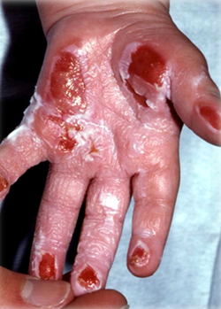
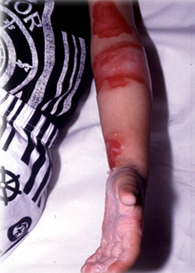
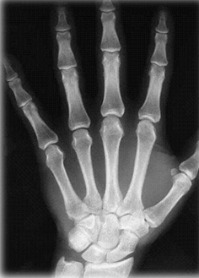
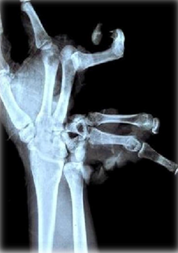
BE
CAREFUL
Notes:
The x-ray picture shows the damage that can be caused to a hand/fingers if a firework goes off in a persons hand.

Slide 12



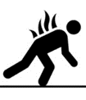

YOUR
SAFETY
If your clothes catch fire:
  STOP!
Stop where you are.
Drop to the ground.
Roll over and over and back and forth until the flames are out.
2. DROP!
GET HELP FROM AN ADULT RIGHT AWAY.
The most important thing to remember is to stay
away from fire.
Only use “stop, drop, and roll” if your clothes are on fire.
3. ROLL!

Slide 13

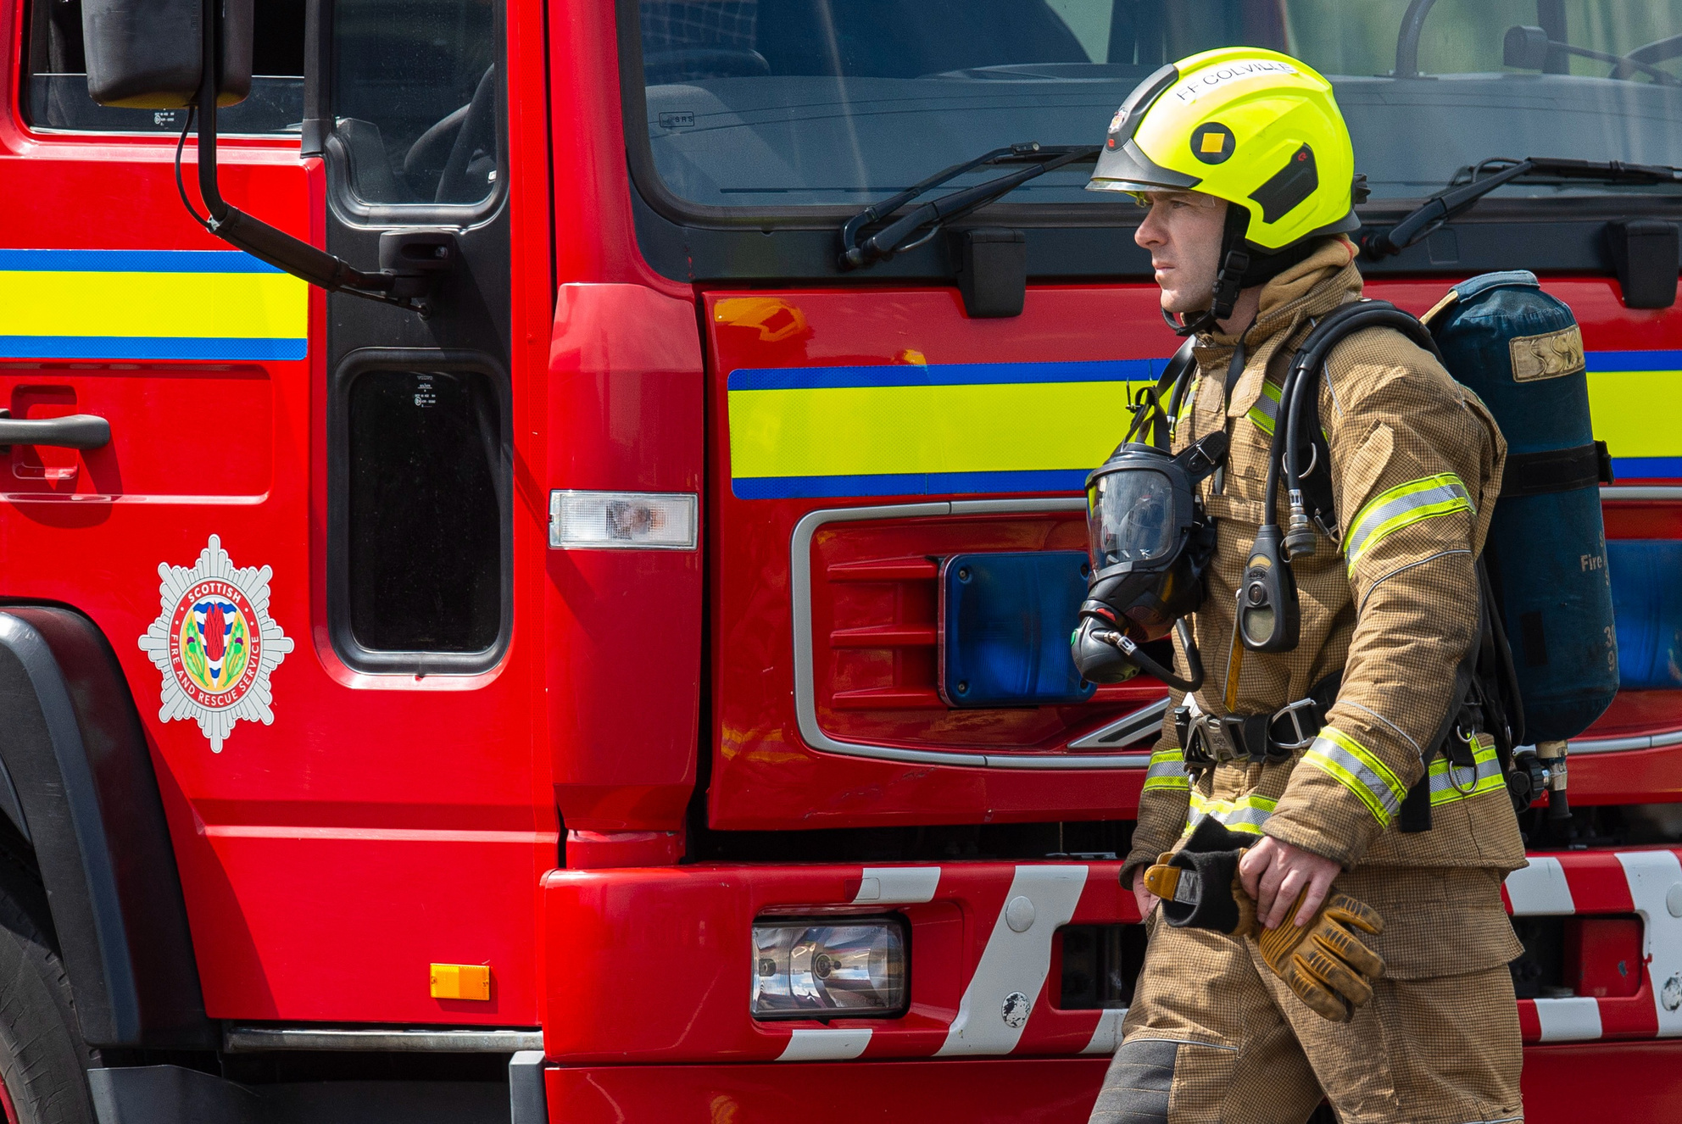
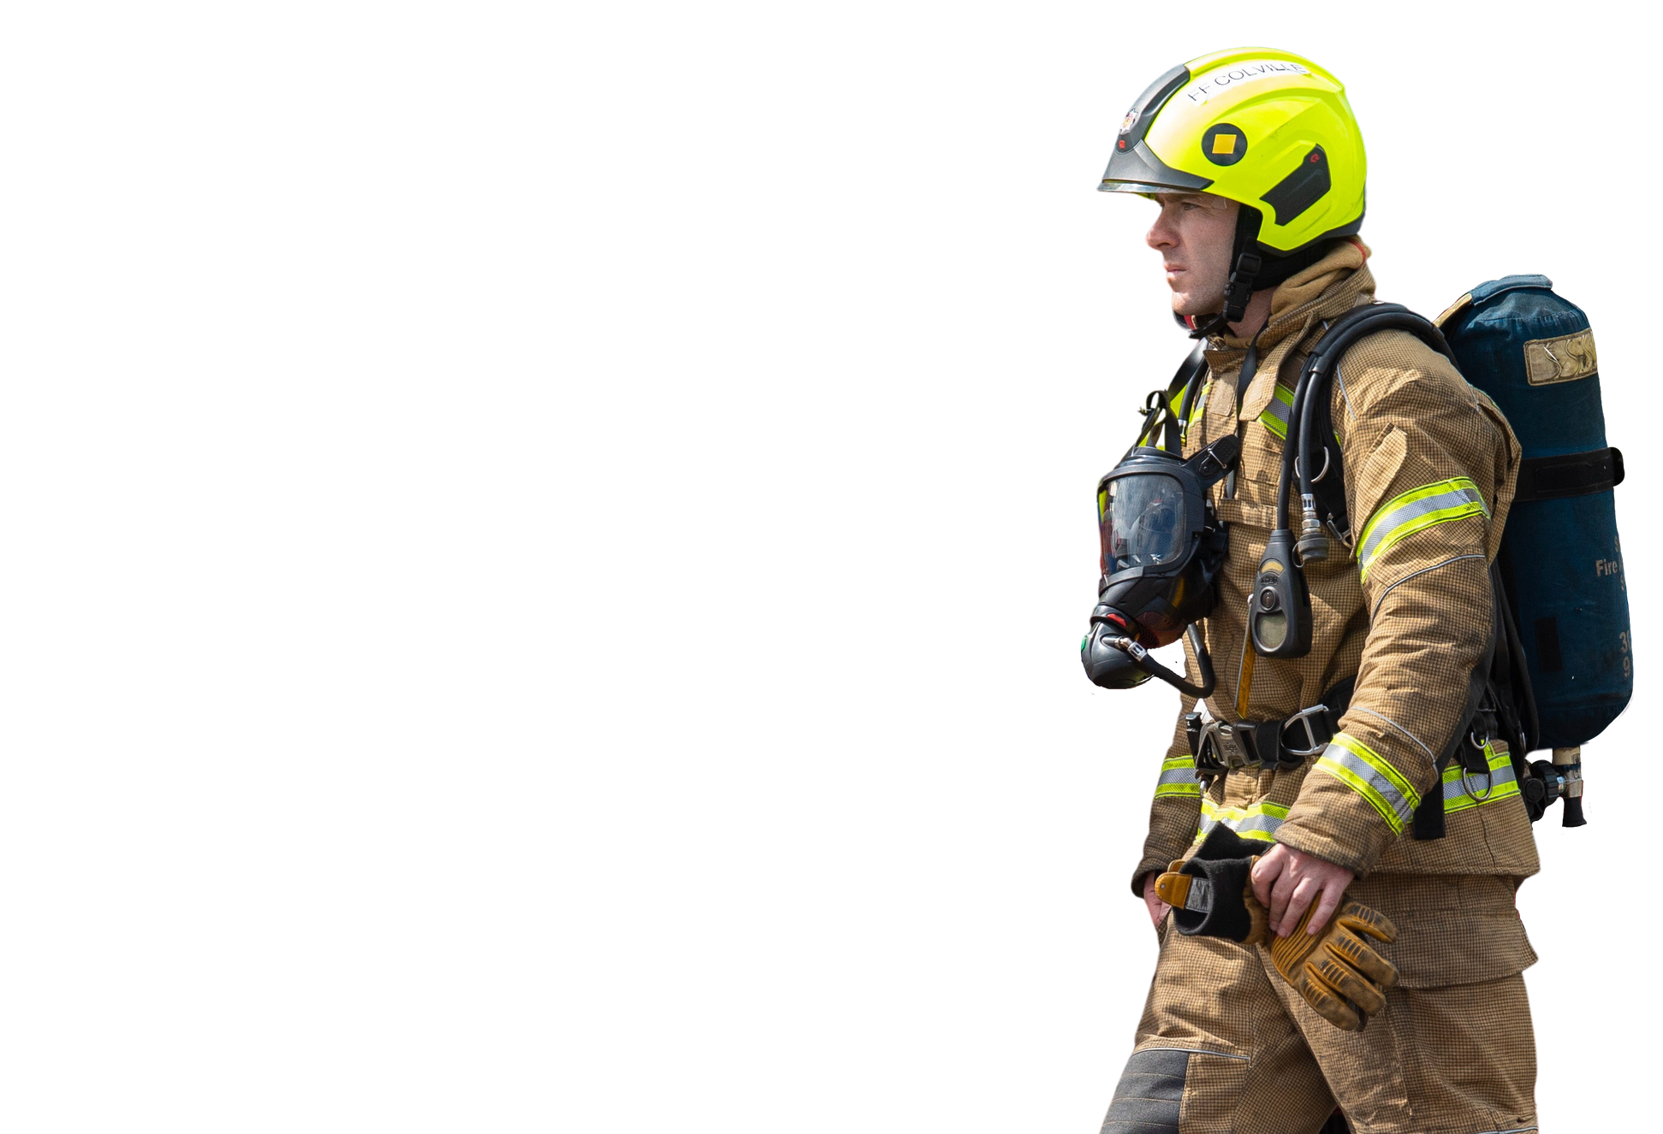

HOAX CALLS
COST LIVES
A FIRE ENGINE CANNOT BE IN TWO PLACES AT ONCE!
All 999 calls are instantly traced
and recorded.
The penalty for hoax calls can be
3 months in prison or a £2,500 fine.
THINK BEFORE
YOU ACT.
Notes:
Hoax Calls Cost Lives
Discuss that if SFRS are mobilised to bonfires that have spread, due to bad planning, or hoax calls, this puts a strain on resources that may be required elsewhere.
Highlight that it is not just hoax calls that put extra strain on SFRS but badly planned and positioned bonfires can lead to fire spread, which could have been avoided if precautions had been taken.
Discuss the details on the slide.
Explain and Discuss
The SFRS could be delayed in attending a real emergency if they are called out to a false alarm. It could be someone you know who is in danger! This is extremely serious as they may not be able to attend fire calls such as:
House Fires
Road Traffic Collisions
Chemical Incidents
The outcome could end in serious injury or even death for the people or families involved
Explain that it is a serious offence to make a hoax call. It may lead to criminal proceedings being brought against any person charged with making a hoax call to the Emergency Services and they can be taken to court.
The penalties can be:
3 months imprisonment or
£2,500 fine
Or both

Slide 14
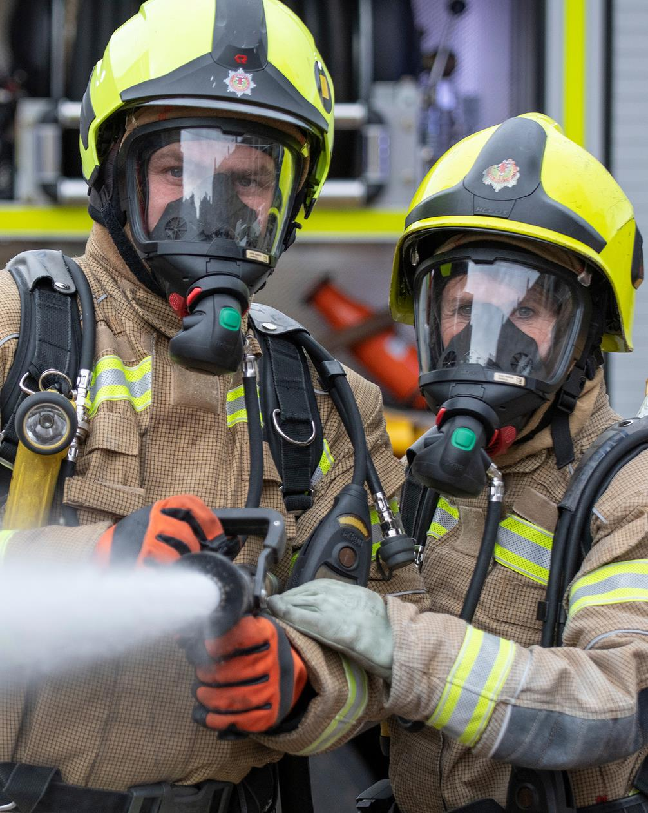
FIREFIGHTERS
ARE HERE TO HELP YOU
Firefighters are here to
keep everyone safe, especially on Bonfire Night.
In 2022
there were five attacks on fire crews responding to incidents during Bonfire Night.
Attacks on Emergency Service Workers
made up 13% of all assaults recorded in Scotland in 2020, averaging 20 incidents a day.
If a firefighter or a fire engine is attacked
they cannot help someone who needs them.
What would happen if someone you loved
needed our help because they were in a house fire or a road traffic incident?
Notes:
Use of vehicle dash cams
Its not only physical attacks but includes verbal abuse.
Some areas will have to wait for police escorts prior to entering.
Ask how many fire engines the area has and then give the correct answer.
Add in that mobilizing an appliance from another area costs time that some people in accidents/fires may not have. In addition, another area is now an appliance down.

Slide 15

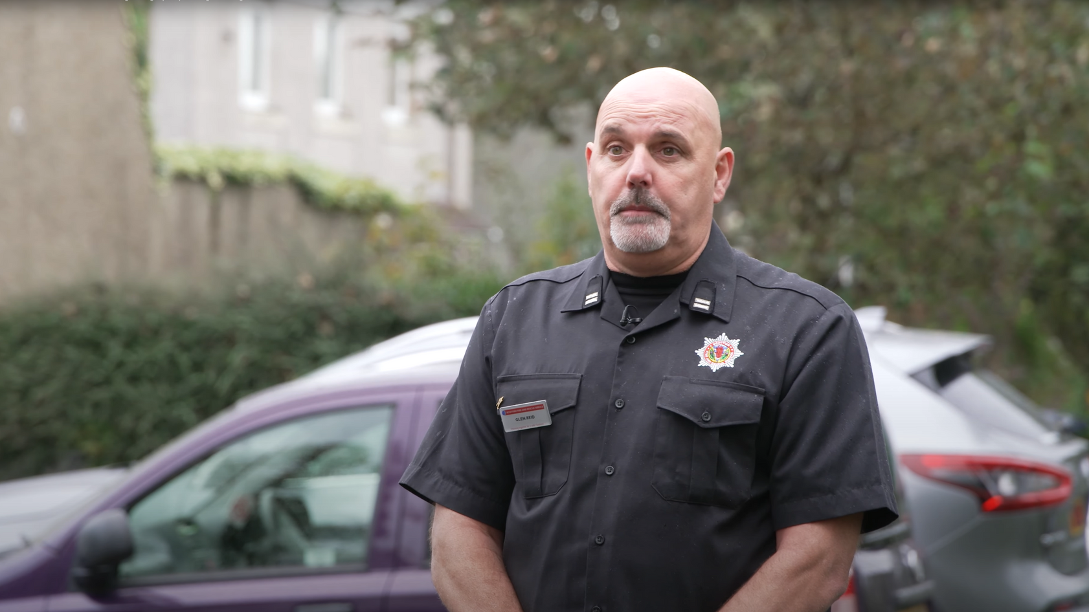

FIREFIGHTERS
ARE HERE TO HELP YOU
FIREFIGHTERS
Attacked
Notes:
Use of vehicle dash cams
Its not only physical attacks but includes verbal abuse.
Some areas will have to wait for police escorts prior to entering.
Ask how many fire engines the area has and then give the correct answer. Add in that mobilizing an appliance from another area costs time that some people in accidents/fires may not have. In addition, another area is now an appliance down.

Slide 16
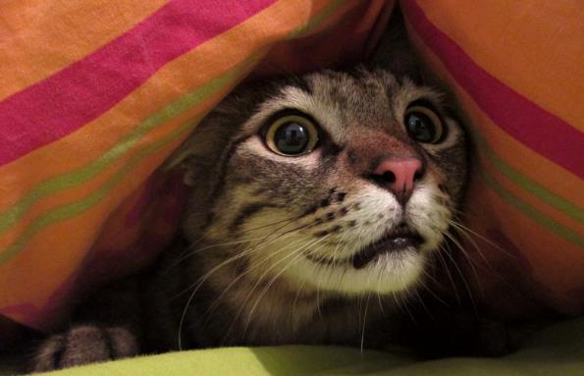
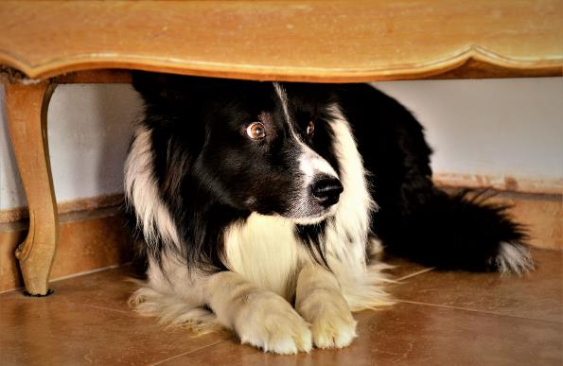
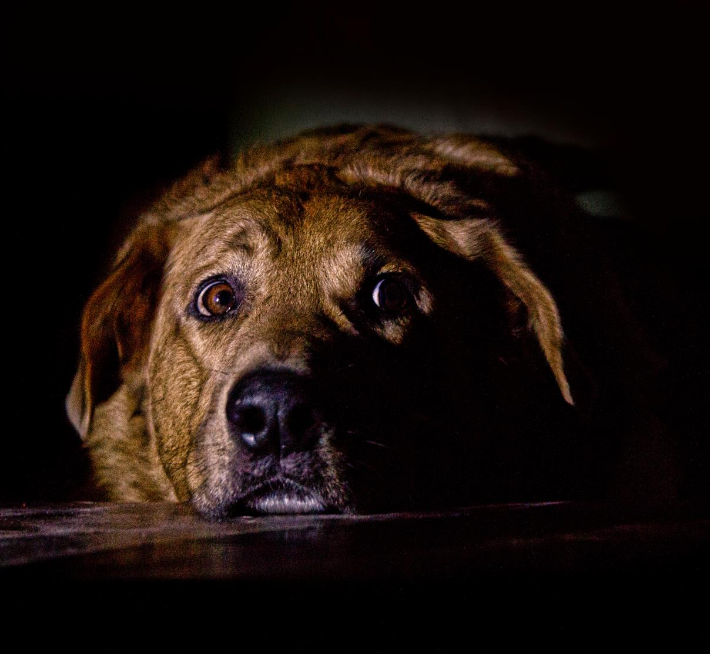
THINK OF ANIMALS
Animals
Often find fireworks particularly distressing. They can become very upset and distressed by the loud noises, bright colours and smoke.

Slide 17
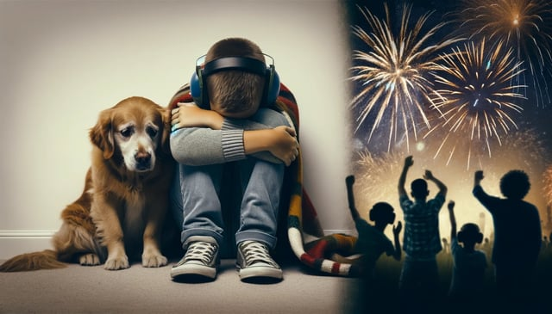
THINK OF OTHERS
Fireworks can be overwhelming for people with sensory needs and autism

Slide 18



REPORTING
Fearless.org is urging young people across Scotland to be fearless in speaking up about fireworks misuse and deliberate fire raising.
This is 100% anonymous through the online form.
WWW.FEARLESS.ORG
Notes:
Discuss Why would reporting something you know, help the fire service?
If you know or suspect anything about fires that have been started deliberately in your area or who is responsible for fireworks misuse, you can be fearless in speaking up 100% anonymously at fearless.org
They can’t track your IP address or any contact details. Simply tell them what you know NOT who you are.
www.fearless.org

Slide 19
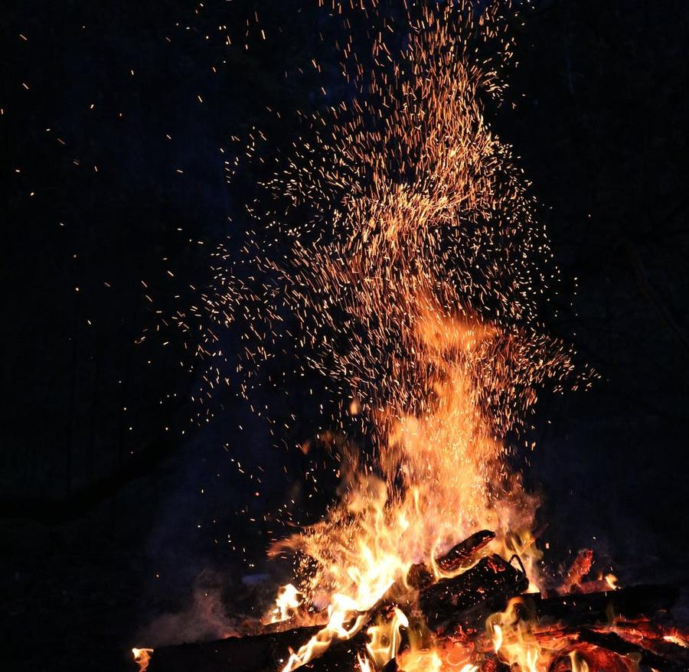
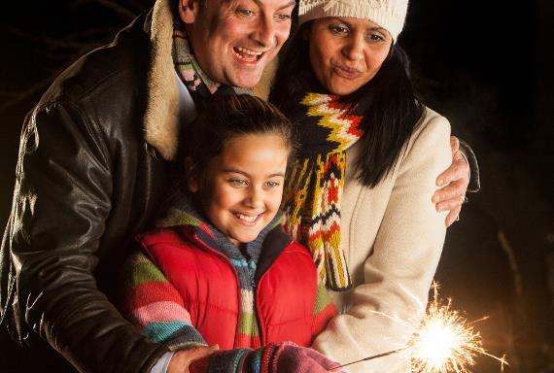

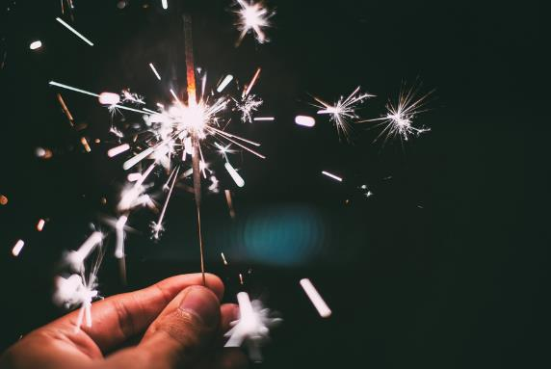
WE WANT EVERYONE TO STAY SAFE ON
BONFIRE NIGHT
Most injuries occur at home. It is safer to attend an organised display.
Organised events can be fun - attend one if you can
You will find a list of these on our website.
Keep reading our safety advice about
bonfires and the use of fireworks.
Notes:
Reinforce that SFRS recommend everyone to attend an organised event. You can find your nearest one on the SFRS website,
And local Press.

Slide 20

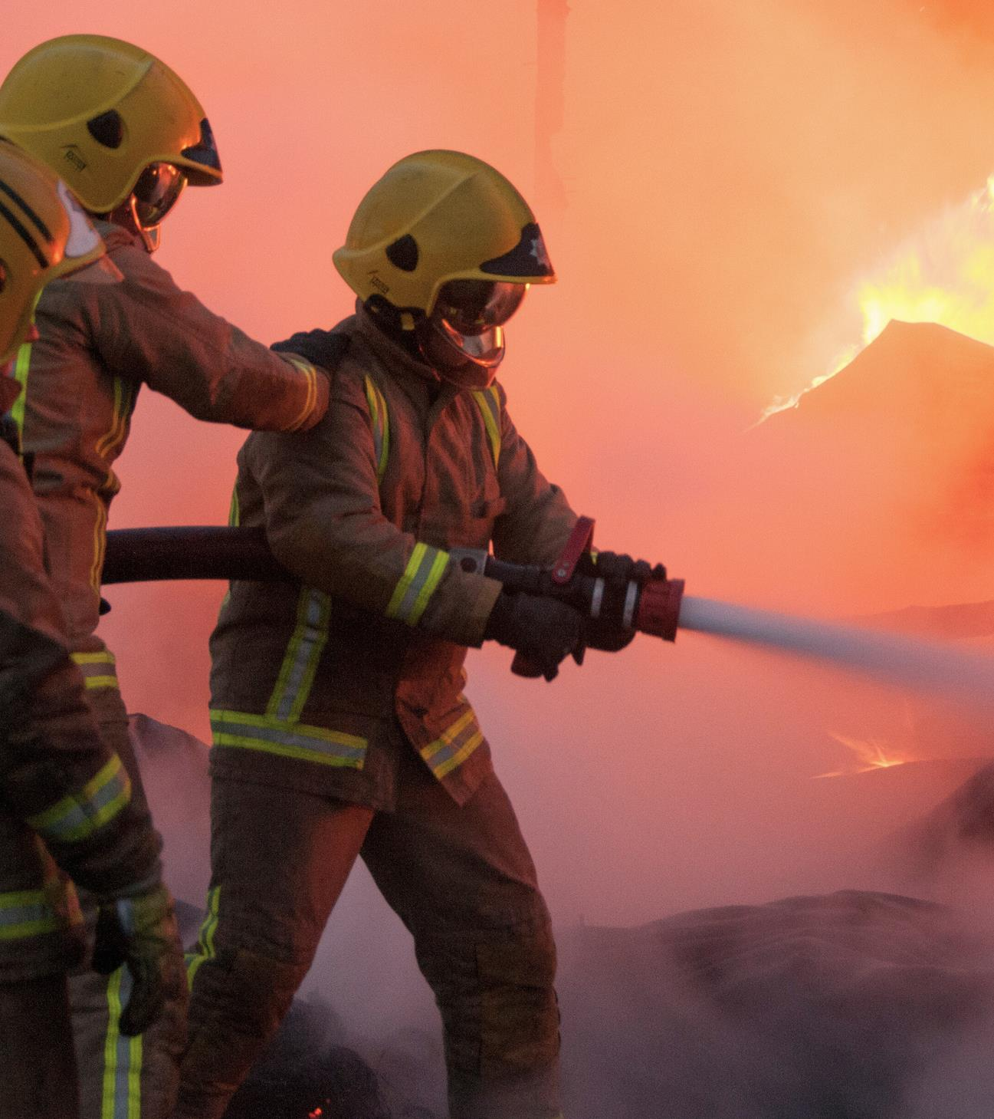


QUESTIONS

Slide 21


FIRESCOTLAND.GOV.UK
FIREWORK & BONFIRE SAFETY
SECONDARY SCHOOL PRESENTATION

